Slide 1


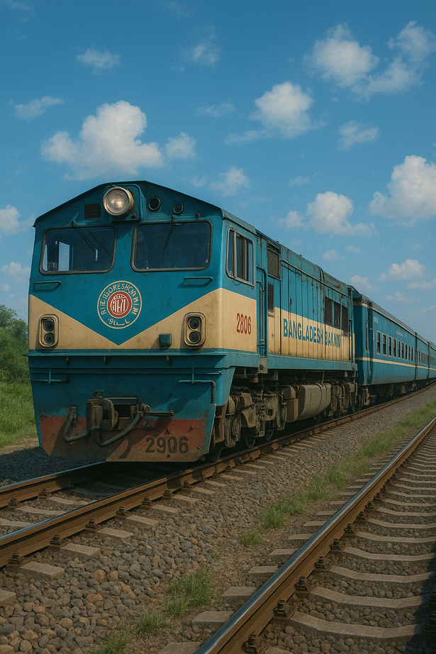
Development of a Smart Railway Traffic Control System for Bangladesh
Asif Akbar
Roll: 2007106
Shaeer Musarrat Swapnil
Roll: 2007116
Presented By
Dr. Muhammad Sheikh Sadi
Professor
Department of CSE, KUET
Supervised By

Slide 2
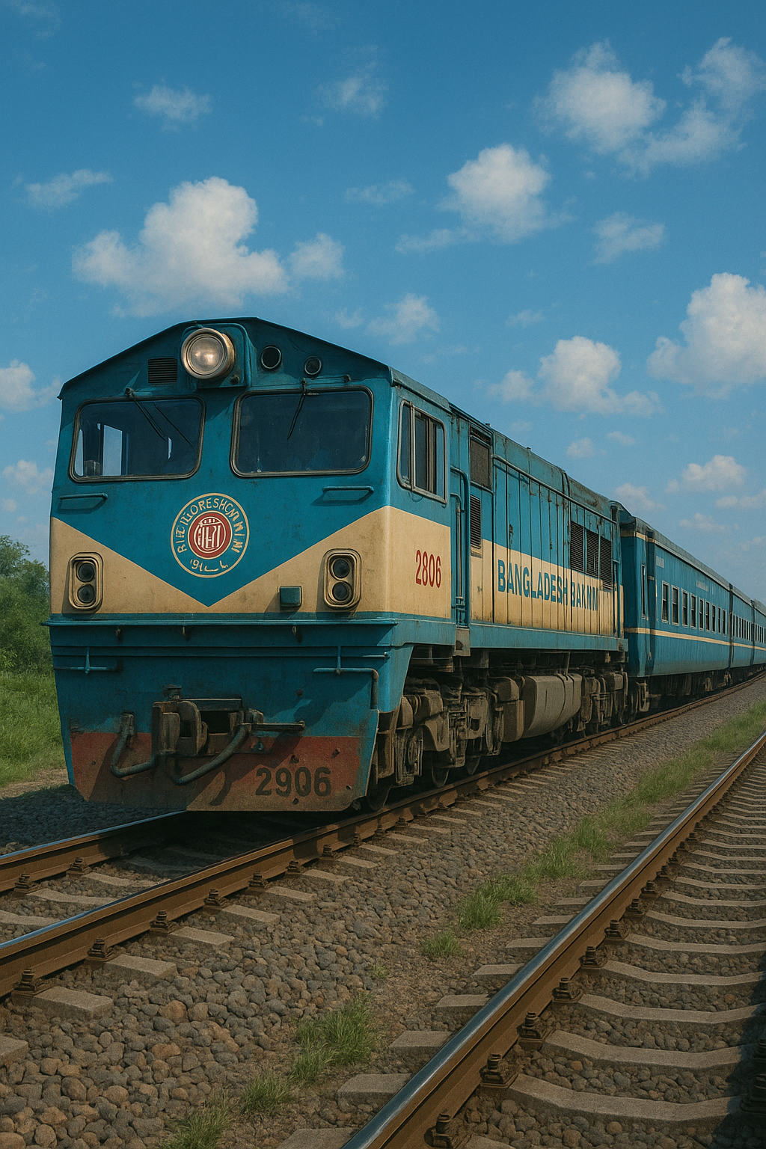
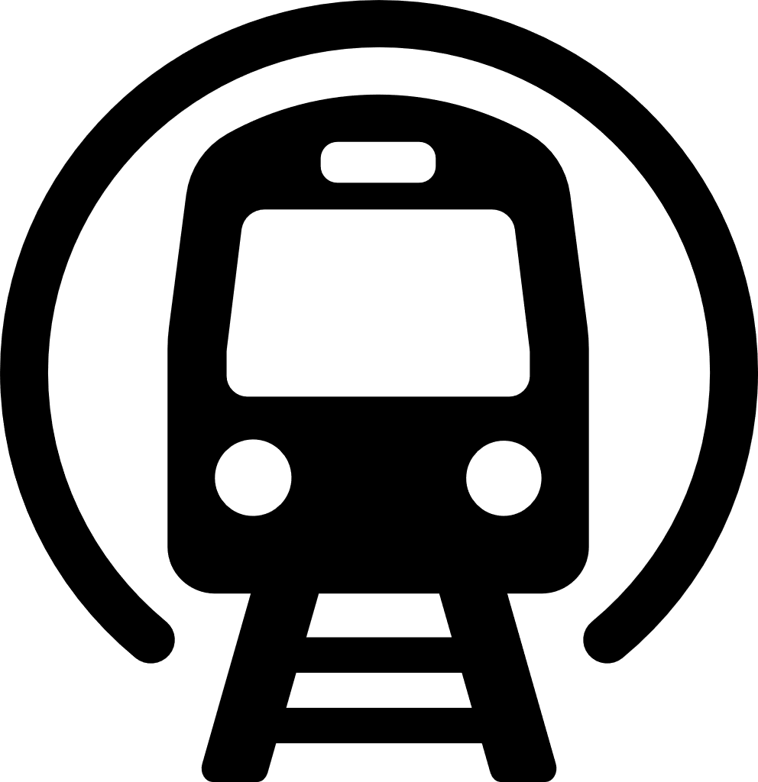


Introduction
Overview
Challenges
Goals
Smart railway system for Bangladesh Railway using IoT to enhance safety and efficiency.
Implement real-time track detection, automated signals, and point switching with future automation.
Manual operations lead to accidents. Real-time monitoring is needed.

Slide 3


Problem Statement
Current System:
Manual control, lack of real-time tracking, and high accident risks.
Automation Need:
Automating train detection and signaling for safer, faster operations.
Track Awareness:
Real-time track occupancy knowledge to prevent conflicts and accidents.

Slide 4



Key Features
Track Detection
Signal Control
Point Switching
LED signals represent Outer, Home, Starter, and Advanced Starter signals, controlled automatically or manually.
DC-based track circuits detect train presence in real-time.
Servo motors simulate point machines for switching between main and loop lines.

Slide 5
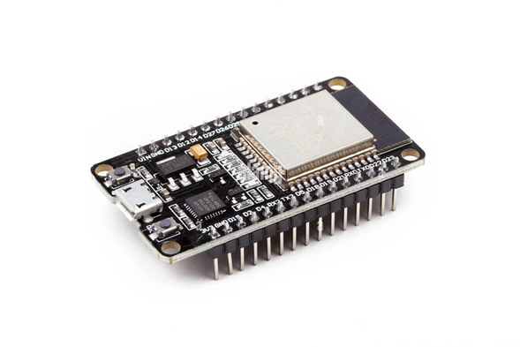
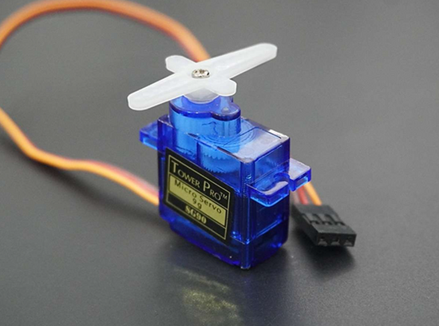
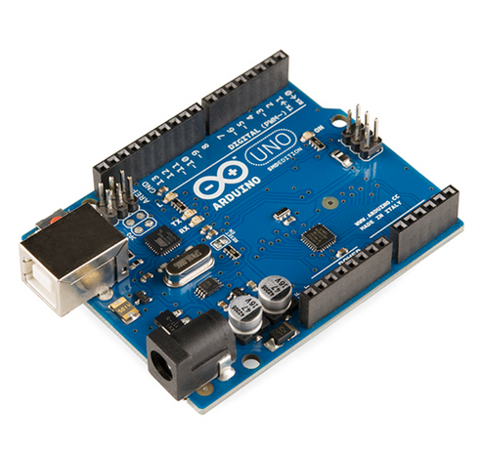
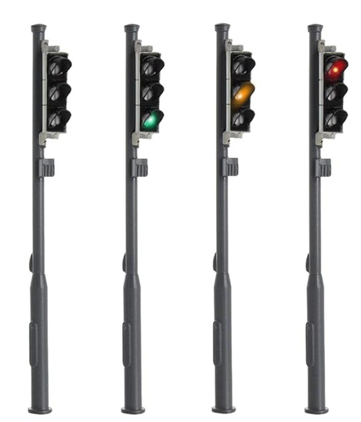
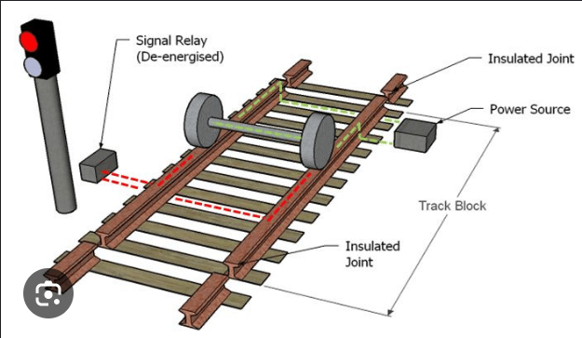
Hardware Components
ESP 32
Servo Motor
Arduino Uno
LED Signals
DC-based Track Circuit

Slide 6
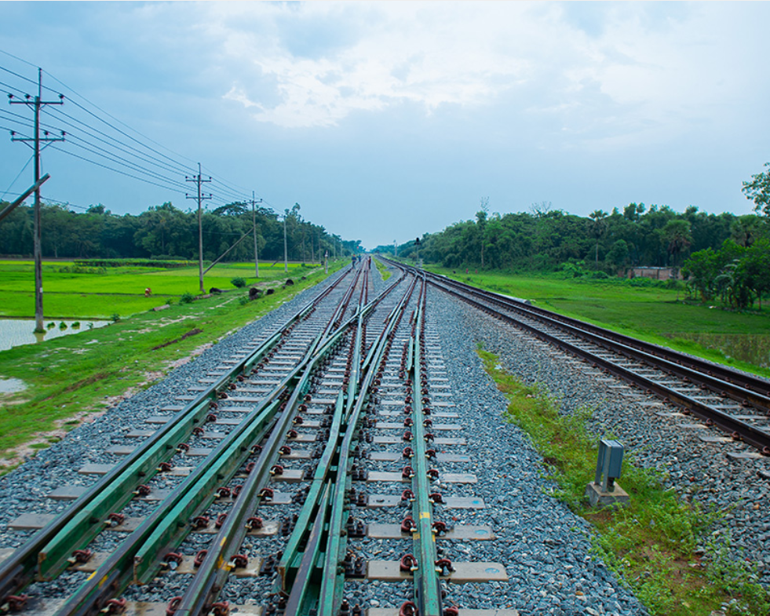


Track Circuit development
Real Track Circuits
Circuit Designed by ESP32
Used globally, with electrical continuity between rails detected by a train's metal wheels, linked to centralized control systems for automated signaling.
The system uses DC voltage through an ESP32 microcontroller to simulate real-world track circuits. Train detection is achieved by completing the electrical circuit with the train's metal wheels

Slide 7
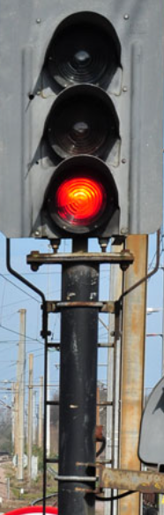
Signal System Design
Outer Signal:
Composed of four lights arranged from top to bottom: Red, Yellow, Green, Yellow.
Indicates whether a train can safely approach the station.
Home Signal:
Consists of three lights in the order of Red, Yellow, Green (top to bottom).
Indicates whether a train can enter the platform or must wait.
Starter Signal:
Has three lights in the order of Red, Yellow, Green (top to bottom).
Shows whether a train can proceed onto another section of track or must wait for clearance..
Advanced Starter Signal:
Contains two lights: Red and Green from top to bottom
It indicates whether a train can use the block to proceed towards the next station.

Slide 8
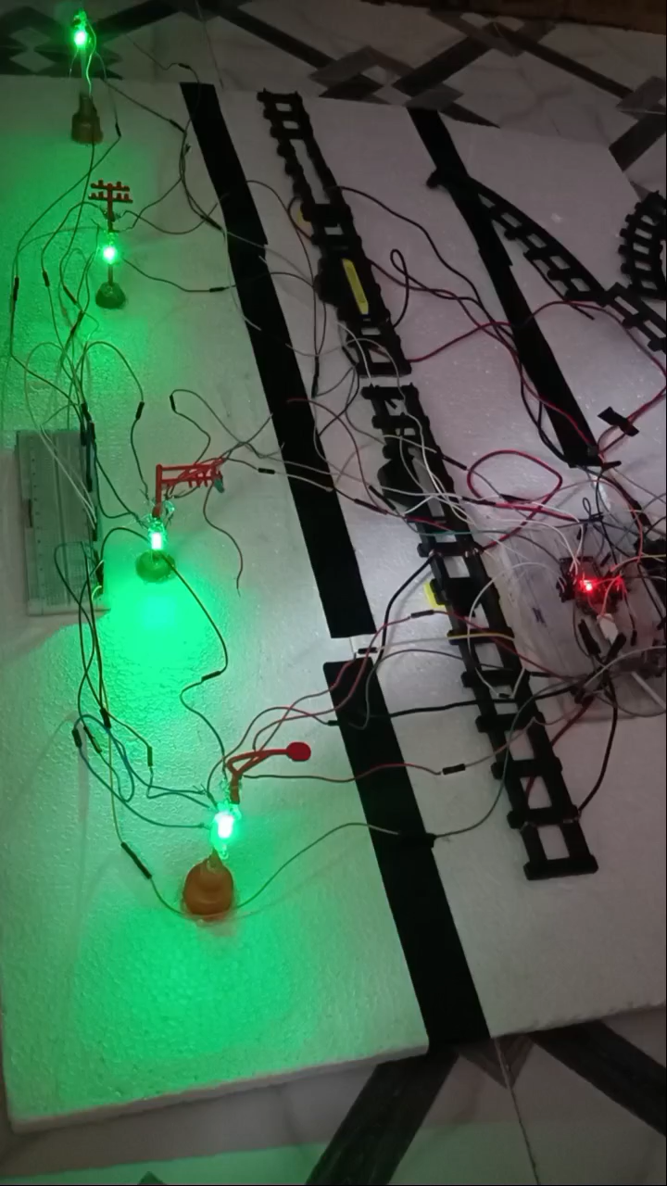
Demo Video

Slide 9
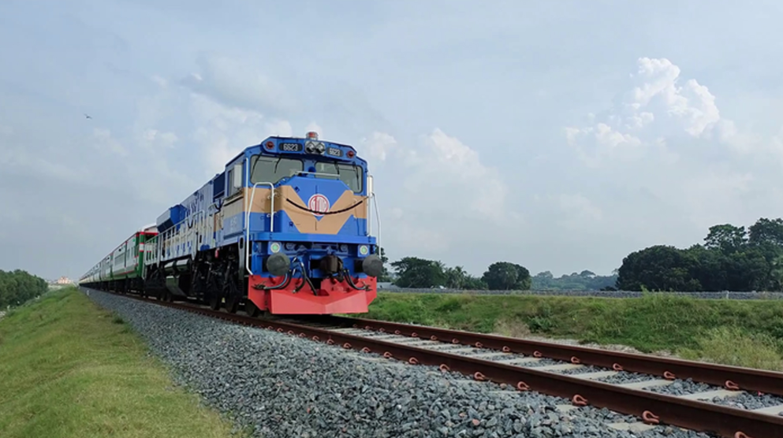
Real-World Application for Bangladesh
Real-World Applications:
real-time monitoring, signal control, and track switching at local railway stations across Bangladesh.
enhance operational safety and efficiency.
Cost-Effective Local Software Solution:
create a scalable, locally-developed software solution to reduce reliance on costly foreign software.
provide Bangladesh Railway with a sustainable and affordable alternative.
Societal Impact:
improve safety, reduce accidents, and enhance the efficiency of the railway system

Slide 10
Further Improvement
Full Automation
Develop a fully automated system for train control, including signal management, point switching, and real-time monitoring.
Advanced Detection Technologies
Integrate axle counters, AI-driven sensors etc. for enhanced train detection and track occupancy.
Scalability to Larger Systems
Expand the system to accommodate multiple tracks and complex interlocking systems for larger stations and networks.

Slide 11
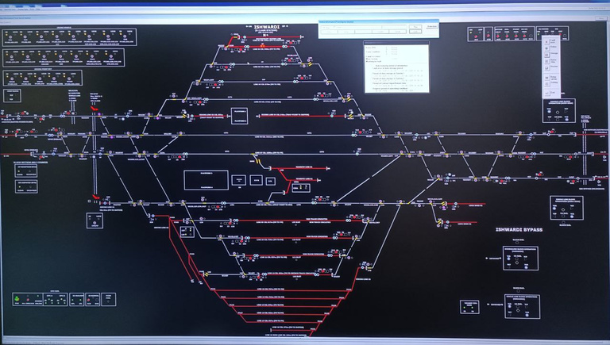
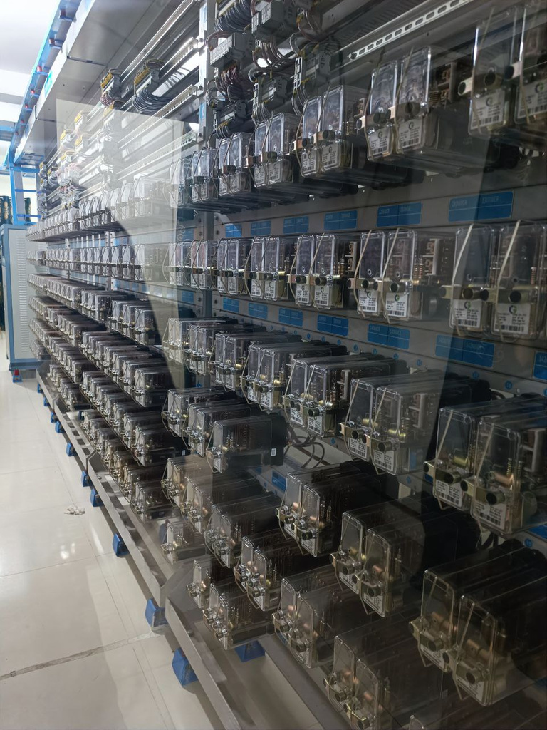
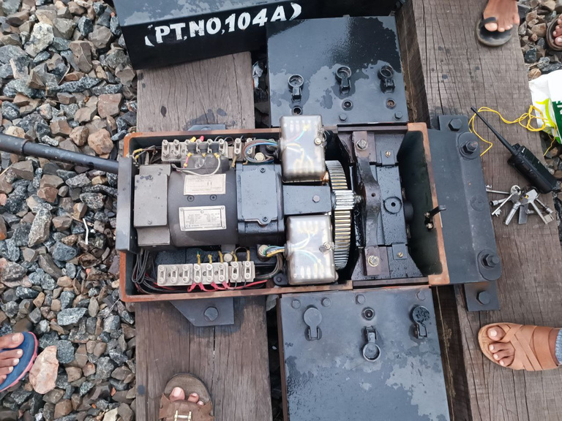
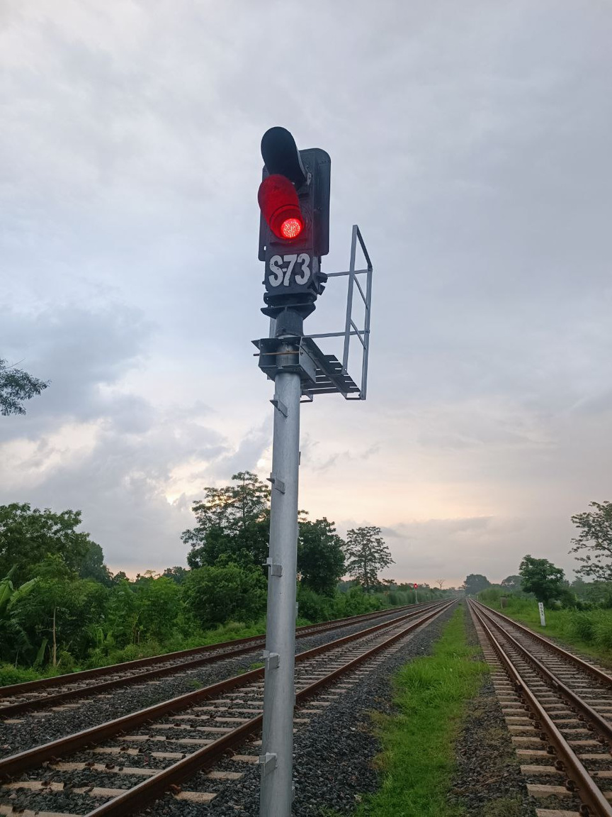
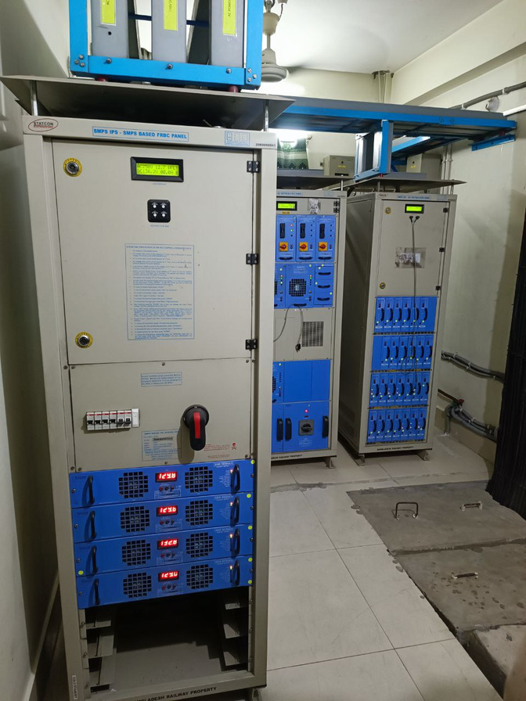
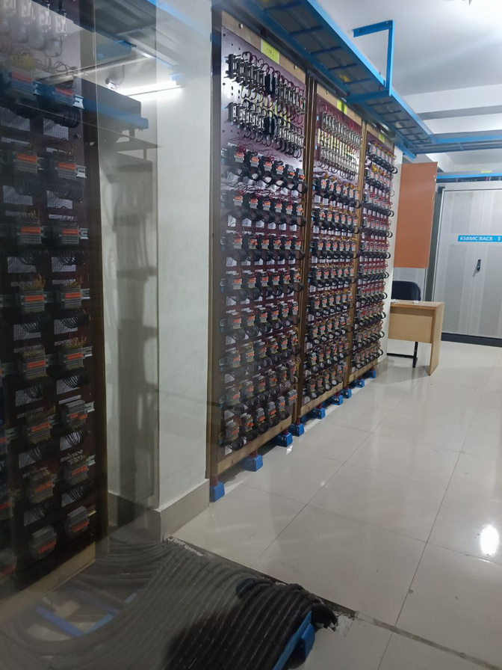
Field Visits and Observations

Slide 12
Thank You

